Slide 1
UX = User Experience
Exchange =Trading/selling item(s)
Experience = exchanged item(s)
UXChange

Slide 2
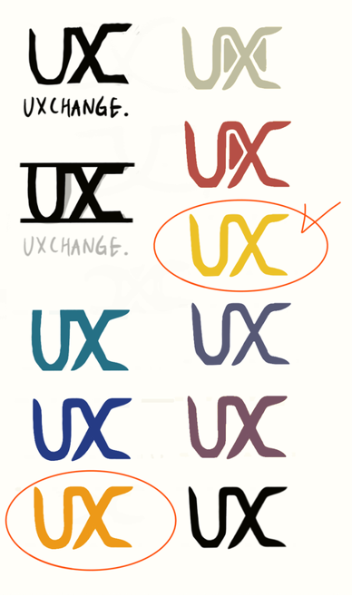
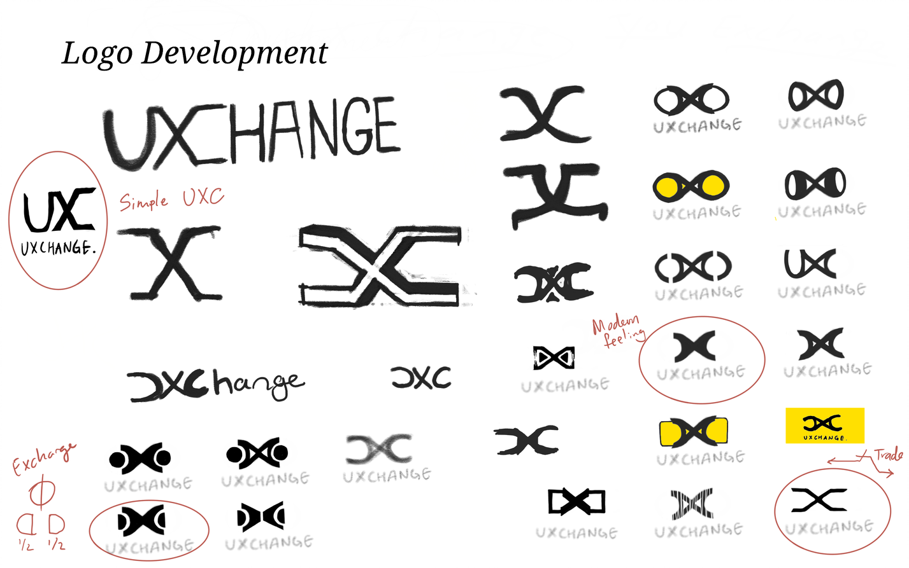

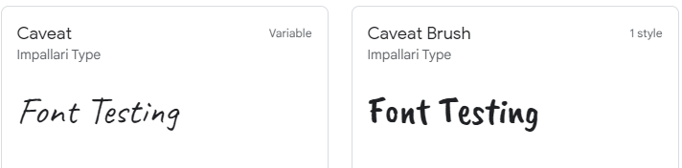
Custom Logo and Theme
Colour codes for web app
rgb(255, 240, 214)
rgb(0, 1, 36, 1)
rgb(255, 204, 0)
rgb(0, 212, 255)
rgb(9, 75, 121)
Typography
rgb(255, 240, 214)

Slide 3
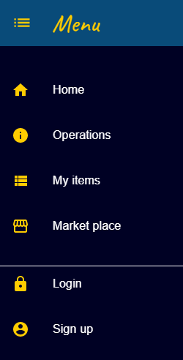
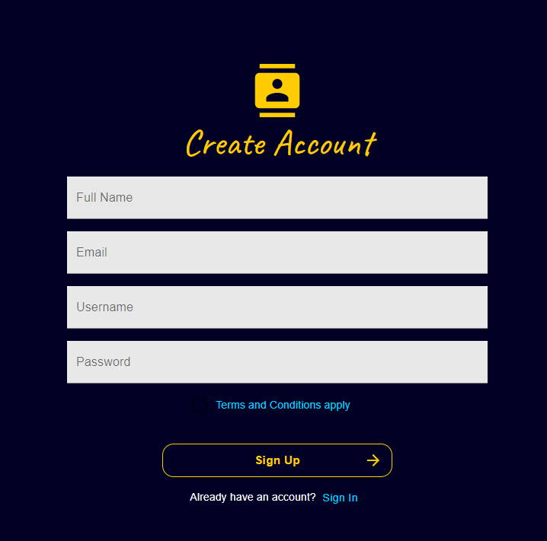
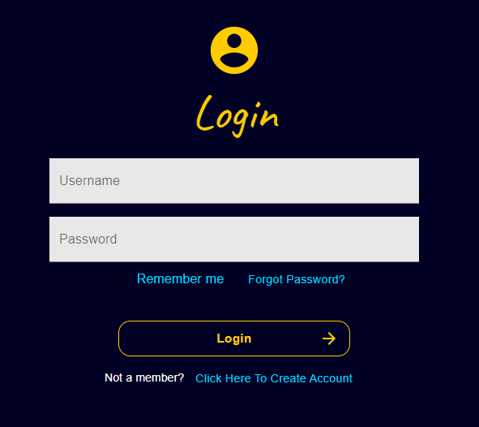
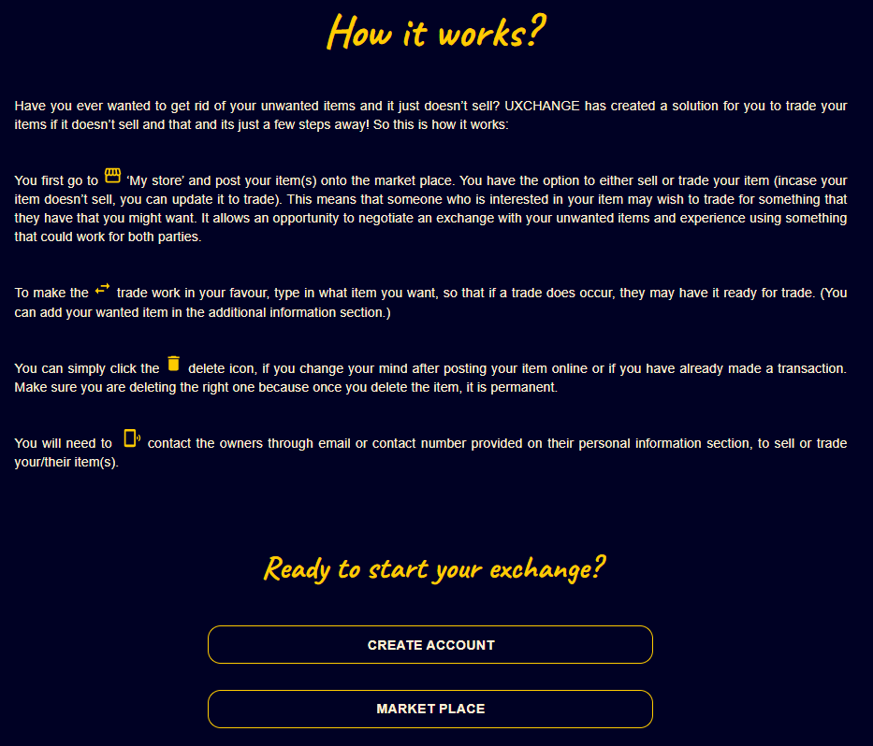
Gettting started with UXchange
1) Create an account to start the web app
Signing up is available from menu or you can ‘Click here to create account’ from the Login form.
2) Signing in - leads to an explanation of how the app will work.
Login from the menu or from the nav bar.

Slide 4

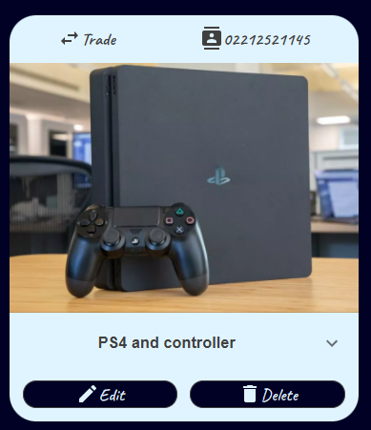
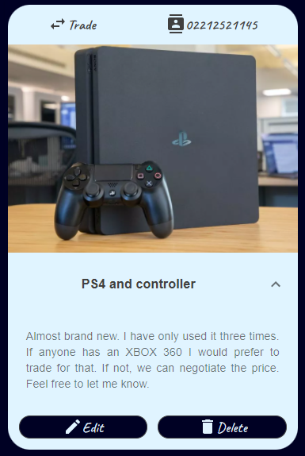
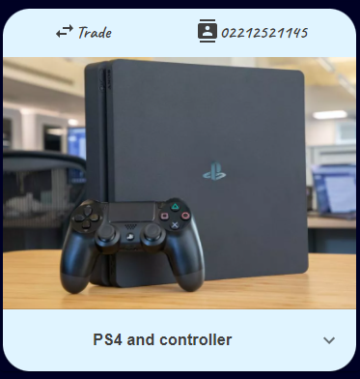
My Items & Market Place
My Items Page
On this page you can create your own Item Post (Ipost) and also be able to update and delete it.
Market Place Page
This is where all Item Post are shown from all users and you can start browsing through them.
Item Post details
1) Trade/Sell option and their contacts.
2) Title of the item and information about it if you click the down arrow button.

Slide 5
Project Reflection
Creating the backend (GraphQL) - saving data to a relational database with Entity Framework.
Apply UseQuery/Mutation React hook to return data and properties with object containing result of the GraphQL query.
DevOps - Testing results with users to see if there could be improvements made to the experience of the web app and udpate those changes made.

